Slide 1
Learning Classifier Systems –
Introduction

Slide 2
Outline
Basic Classifier System operation
  Typical problems solved by LCS
Encoding and generalisation
Action sequences
Sizes of rules and rulebase
Exploration and Exploitation
Extension for more complex problems: XCS
XCS: Typical sequence of actions

Slide 3
Basic Classifier System Operation
Get input, choose matching action, get reward.
Store acquired knowledge: How well did some action perform given a specific input? ⇨ Rule base
Classifier: Structure to store input, action and fitness.
Simple approach: Binary code, avg. reward as fitness.
Use fitness to decide between rules in case more than one classifier matches.
Learning: Generate new classifiers (GA; recombination, mutation), evaluate classifiers → update fitness.
Sensor input | Action | Fitness
000101001 | 01 | 0.4
101101011 | 11 | 0.9

Slide 4
Typical problems solved by LCS (1)
Single step problems: Immediate reward.
  Example: Boolean Multiplexer.
  Input: Binary string, length l=k+2^{k}. The first k bits represent the address of a bit in the last 2^{k} bits whose value is to be returned.
  l=6: 100010 Address: 10₂ = 2₁₀ Value: 1
  Corresponding Classifier:
  100010:1 (Condition:Action)
  Correct answer: reward; wrong answer: no reward or penalty ⇨ choose classifiers by average reward.
Notes:
Classifier: Noch kein Wert angegeben (Vereinfachung)

Slide 5
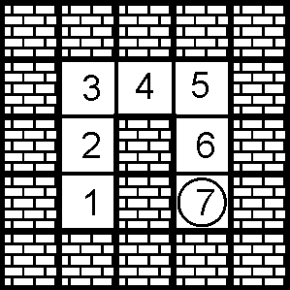
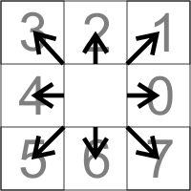
Typical problems solved by LCS (2)
Multi-step problems: Delayed reward.
  Example: Woods (animat, maze).
  Task: Move to target field (7), use
  shortest path.
  Reward only for reaching target.
  Input: Sensor data about adjacent cells (0: free; 1: blocked).
  Output: Move to adjacent cell (8 possibilities).
  Example Classifier:
  01110010:111
Focus of current research

Slide 6
Generalisation: Wildcards
Efficiency: Keep rule base small.
Avoid redundant information.
Example: Multiplexer
100010:1 and 101111:1: Different input, same output.
Use a third symbol # as "don't care" / wildcard:
10##1#:1 covers 8 different inputs and gives always correct output.
Classifiers can be subsumed, size of population can be reduced.
Problem: Make sure no information is lost (relevant for more difficult problems).

Slide 7
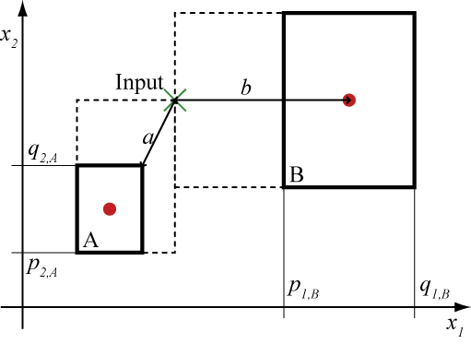
Alternatives to binary code
Problem: Coding must allow for wildcards to make sense. Binary: #01 covers 101₂/5₁₀ and 001₂/1₁₀ .
Gray-Code: Two consecutive numbers differ only by 1 bit, but arbitraryly placed wildcard can still lead to non-continous region covered.
Fuzzy Logic: No wildcards necessary, but action must allow for “overlay”.
Real values as intervalls: “unordered bound representation” allows for “widening” of condition.

Slide 8

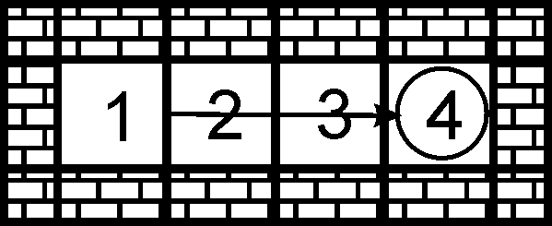
Learn a sequence of actions
Ripple reward through all classifiers used to reach goal.
  Update of fitness values is delayed by one time step.
  Reward: External reward + discounted fitness value of classifiers chosen in current time step.
Experiment 2:
Step 2: Choose Cl 2 (f: 0),
reward: 0 → Cl 1.
Step 3: Choose Cl 3 (f: 100),
reward: 0 + *100 = 50 → Cl 2.
Step 4: Goal reached,
reward: 100 + 0 = 100 → Cl 3.
Cl: Classifier, f: fitness value, : discount rate = 0.5
 |  | Classifier
 |  | 1 | 2 | 3
Experiment | 1 | 0 | 0 | 100
 | 2 | 0 | 50 | 100
 | 3 | 25 | 50 | 100
Fitness values of classifiers
Notes:
Stabilisierung durch Learning rate: fitness(t) = fitness(t-1) + beta * delta → kein Überschwingen, einzelne Ausreisser haben weniger Einfluss.
„Fitness values“ vereinfacht im Vergleich zu XCS.

Slide 9
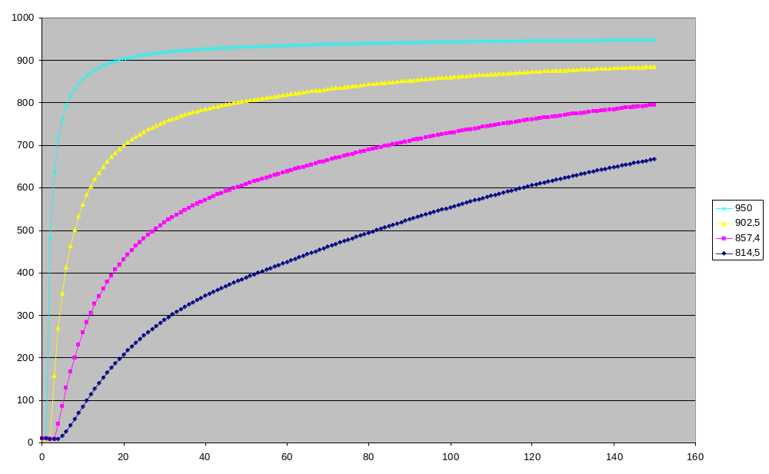
Delayed Convergence
Notes:
Fitnesswerte mehrerer Classifier. Optimale Sequenz: Blau, Magenta, Gelb, Cyan -> Ziel. Bei Classifiern, die weiter vom Zielfeld entfernt zum Einsatz kommen, konvergiert der Fitnesswert langsamer, da dafür zunächst die Fitnesswerte der in der Sequenz vorhergehenden Classifier konvergieren müssen.

Slide 10
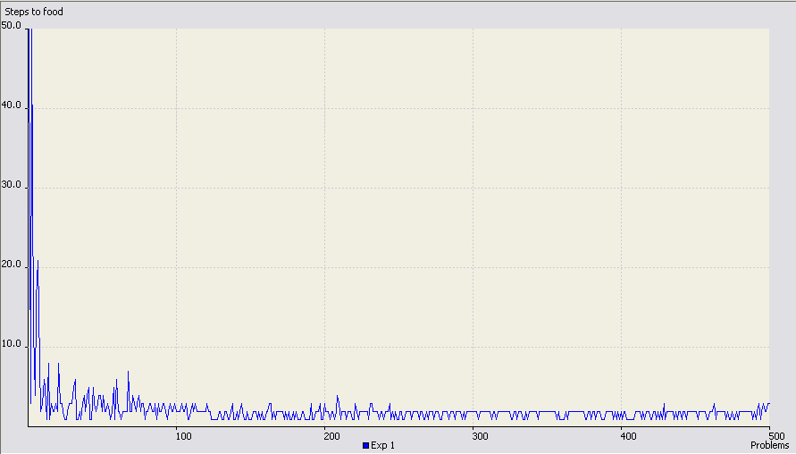
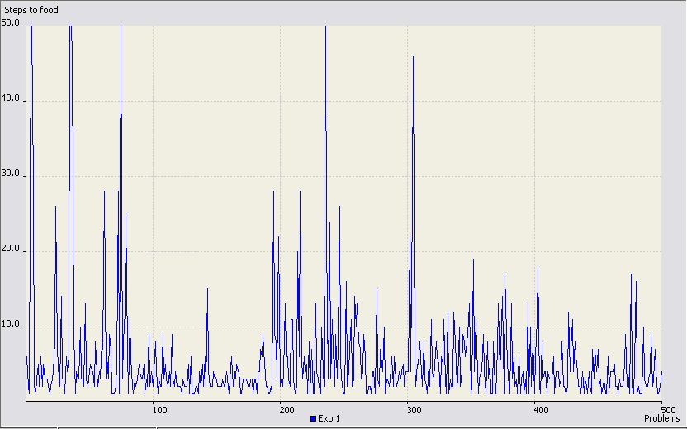
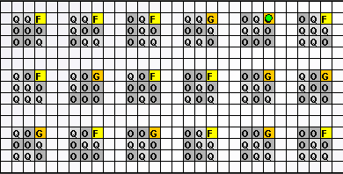
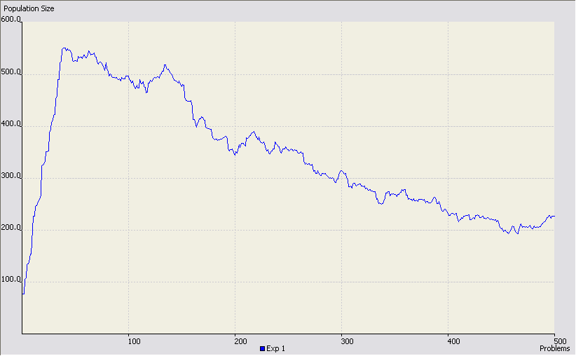
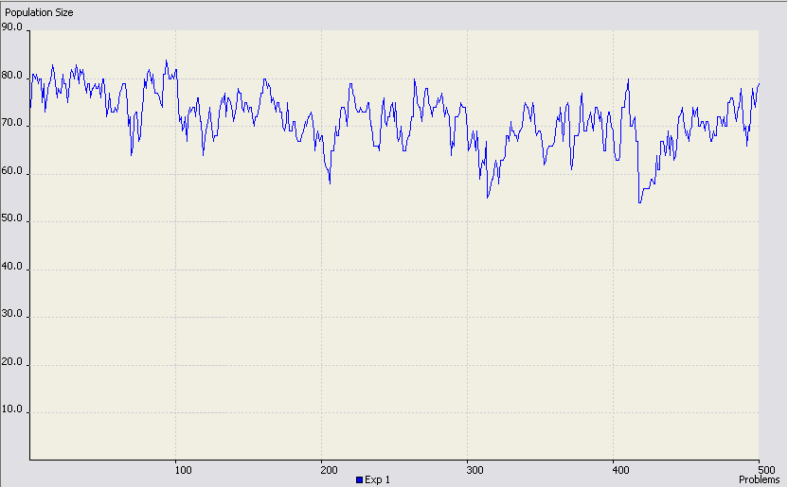
Parameter: Size of Rulebase
Notes:
Links: Max. Populationsgröße (unteres Diagramm) 600, wird nicht erreicht, limitiert Lernen nicht, Zielgröße (Steps to food, oberes Diagramm) fällt schnell auf optimale Werte (Konvergenz).
Rechts: Max. Populationsgröße begrenzt auf ~80, ist zu wenig für das gegebene Problem, Zielgröße zeigt keine Konvergenz.

Slide 11
Example: Traffic Light Controller Rules
Action part:
  1 parameter (3 bit) minimum, 9 parameters (~16 bit) per phase ≈ 18 to 96 bit for average TLC
Condition part:
  1 parameter (6 bit) minimum, 2 to 3 parameters likely ≈ 6 to 18 bit
Overhead:
  Prediction, prediction error, fitness, experience ≈ 32 bit
Total: 56 to 146 bit for single rule

Slide 12
Use what you know or learn something new?
Exploration vs. Exploitation: Learning implies wrong or at least non-optimal actions.
Exploitation of acquired knowledge: Always use classifier with highest fitness value.
  Deterministic behaviour,
  evaluation of (few) classifiers becomes more reliable,
  no improvements of knowledge.
Exploration of new possibilities: Generate new classifiers, choose classifier randomly.
  Enhance knowledge about problem,
  performance worse than optimum,
  dangerous / illegal actions?

Slide 13
Algorithmic description
Select all classifiers in the population with condition matching input → Match set [M].
Choose an action present in [M]: For every distinct action present, compute average fitness value of classifiers with that action.
  Exploitation: Choose action with highest fitness value.
  Exploration: Choose action randomly.
All classifiers in [M] with chosen action →
Action Set [A].
Compute reward: External reward + highest discounted average fitness value in [M].
Update fitness values of classifiers in previous action set [A]₋₁ with this reward.
Notes:
Reward aus [M], da sonst bei exploration Verfälschung des Ergebnisses. Für Bewertung also Annahme: Exploitation.
Reine Exploitation selten, meist gewisser Zufallsanteil (z.B. Roulette Wheel Selection, also fitness proportional probability).

Slide 14
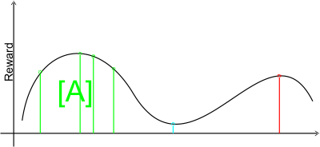
Classifier generation
Two sources for new classifier:
  Genetic Algorithm: Chooses two members of Action Set (probability proportional to fitness value) → two new classifiers (crossover). Offspring subject to mutation.
  Niche-GA: Recombination of similar classifiers; mutation to cover entire problem space.
  Covering: No matching classifier available → generate classifier with matching condition and random action.
Notes:
Vorteil Niche: wenn nur innerhalb des ActionSet ausgewählt wird, ist unwahrscheinlicher, daß die Nachkommen in einem völlig anderen Bereich des Suchraums liegen. Nur die Fitness sagt dazu nichts aus: Grün plus Rot kann Blau ergeben → geringe Fitness.
Populationsgröße wichtiger Parameter.
Covering auch möglich, wenn nur schlechte Classifier vorhanden sind.

Slide 15
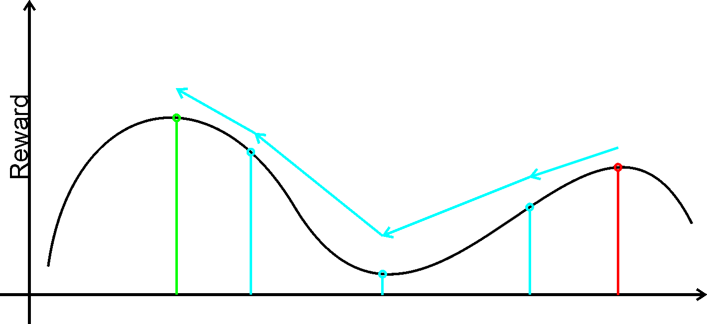
Average reward: Enough for optimal performance?
Classifiers with low fitness are removed from population.
Low-reward actions might be necessary to reach global optimum, but are removed due to low fitness.
Very general classifiers might get higher average reward than more specific classifiers with actually better action.
Extension: Fitness for reproduction and deletion based on accuracy of prediction → XCS (Wilson).
Notes:
Relevant nur, wenn nicht nur am Ende externer Reward zugeteilt wird (sonst pflanzt sich der externe Reward vom Zielzustand ohnehin auf kürzestem Wege zurück).
Accuracy wird auch genutzt, um den Beitrag eines Classifiers bei der Berechnung der Bewertung einer Aktion zu skalieren.

Slide 16
Classifier
Classifier consists of:
  Condition: Matched against input
  Action: What to do if chosen
  Prediction: What reward to expect if action is executed
  Prediction error: Average difference between prediction and actual reward
  Fitness: Function of inverse of prediction error
  Experience: How often contained in Action Set
  Average Action Set Size
p
ε
F
exp
as

Slide 17
Reward/Payoff
Due to Q-Learning-like learning in XCS, payoff consists of two components:
  any received external reward ρ
  payoff prediction of best possible action in next state
Payoff can only be computed after next Matchset is known
P= ρ + γ * max(PA)
P: Payoff
ρ: Reward
γ: discount factor (~0.7)
PA: Prediction array

Slide 18
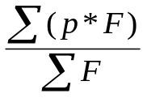
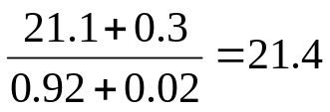
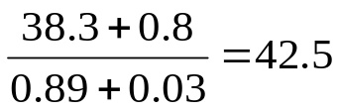
Action sequence
Input:
Population:
Matchset:
Predictions:
Actionset:
Output:
23 * 0.92 = 21.1
3
B:1 52 12 0.67 10
43 * 0.89 = 38.3
D:4 12 08 0.32 54
15 * 0.02 = 0.3
A
Matching
A:3 43 28 0.89 04
26 * 0.03 = 0.8
Reward:
Niche GA
F:2 73 03 0.95 31
Action
A:1 15 14 0.02 32
37
Condition
Fitness F
A:3 26 23 0.03 21
Computation:
S:1 48 28 0.22 15
Classifier:
A:1 23 03 0.92 23
Prediction p
Experience exp
Prediction error ε
PredictionArray:
Action:
1
2
3
4
Prediction:
21.4
null
42.5
null
Update previous Actionset
Max:

Slide 19
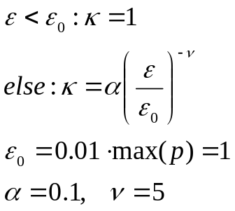
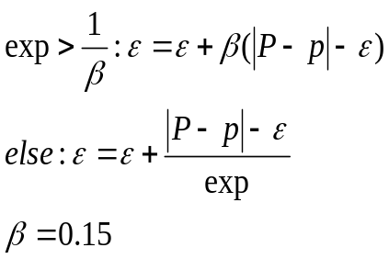
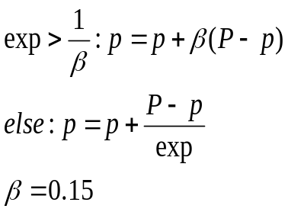

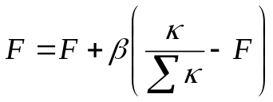
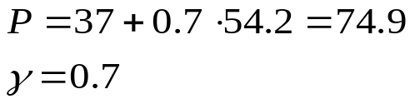
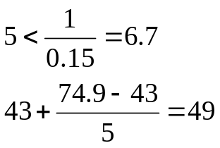
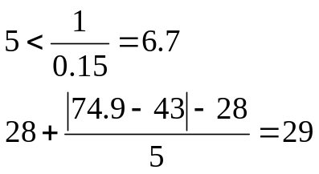
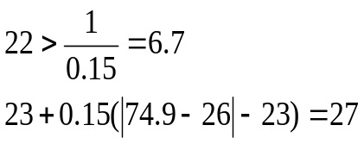
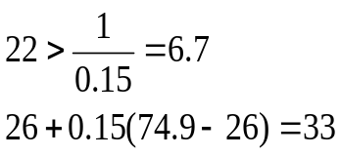
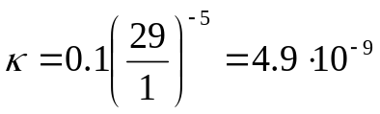
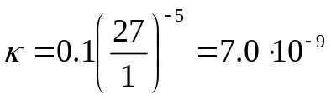
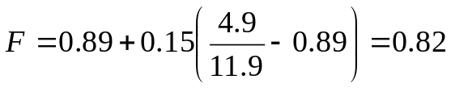
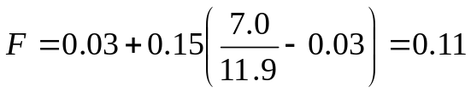
Update of parameters
Previous
Actionset:
Payoff:
Experience: increment
Compute Payoff
Prediction error
Prediction
Accuracy
Fitness
A:3 43 28 0.89 04
κ=4.9·10⁻⁹
A:3 43 28 0.89 05
A:3 43 29 0.89 05
A:3 49 29 0.89 05
A:3 49 29 0.82 05
74.9
A:3 26 23 0.03 21
A:3 26 23 0.03 22
A:3 26 27 0.03 22
A:3 33 27 0.03 22
A:3 33 27 0.11 22
κ=7.0·10⁻⁹
Accuracy Sum:
Σκ=11.9·10⁻⁹
Previous
Reward:
37
Computation:
Current
PredictionArray:
Max:
42.5
54.2

Slide 20
Remarks: Fitness
Fitness: choose between two classifiers
XCS: Choice when
  building Action Set (contribution to Prediction Array)
  applying GA
Therefore: No global fitness necessary, only relative fitness with respect to ”typical“ Action Set.
Sum of fitnesses of frequently chosen Action Sets converges to approx. 1
Fitness in the XCS-sense is only one among a number of parameters giving a classifier‘s ”value“.

Slide 21
XCS: Schematic View
Environment
0011
Population [P]
Input String
ρ ε F
#011 : 01 43 .01 99
11## : 00 32 .13 9
#0## : 11 14 .05 52
001# : 01 27 .24 3
#0#1 : 11 18 .02 92
1#01 : 10 24 .17 15
…
execute Action
Reward
Prediction Array
action
selection
Action Set [A]
Match Set [M]
00 01 10 11
nil 42.5 nil 16.6
#011 : 01 43 .01 99
#0## : 11 14 .05 52
001# : 01 27 .24 3
#0#1 : 11 18 .02 92
#011 : 01 43 .01 99
001# : 01 27 .24 3
max
discount
+
GA
Previous Action Set
[A]₋₁
Notes:
GA auch auf Action Set möglich. Prediction p, Prediction Error e, Fitness F.

Slide 22
Thank you for your attention

